Slide 1
Focal Modulation Networks (FocalNets)
Microsoft Research Redmond | Microsoft Cloud + AI NeurIPS 2022

Slide 2
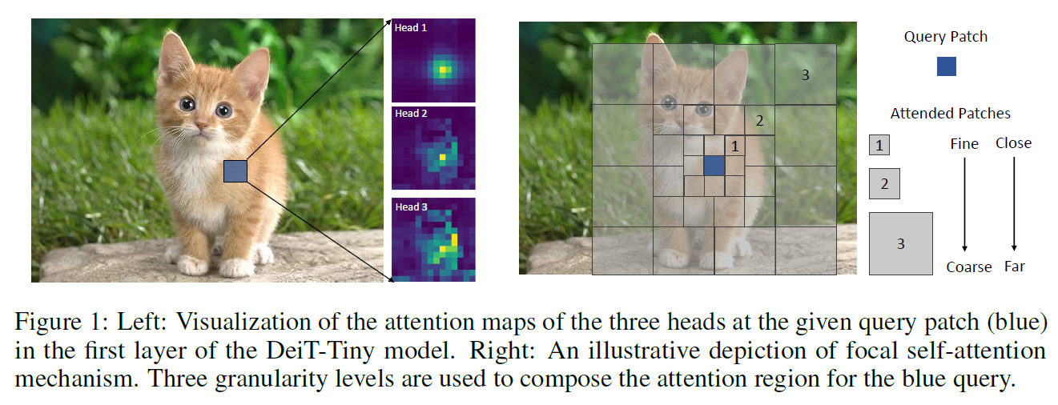
Focal Attention: Brief Review
Models both short- and long-range interactions.
By fine-grained local attention + coarse-grained global attention.
Notes:
A query token in the feature map attends its closest surroundings at the finest granularity as itself. However, when it goes to farther regions, it attends to summarized tokens to capture coarse-grained visual dependencies. The further away the regions are from the query, the coarser the granularity is.
DeiT = Data-Efficient Image Transformer

Slide 3
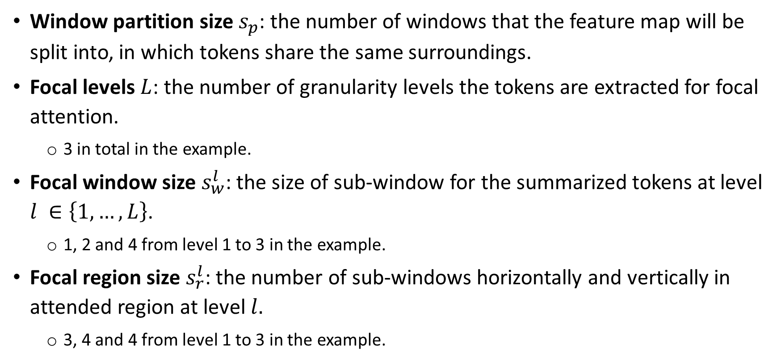
Focal Attention Mechanism
Window partition size $s_{p}$: the number of windows that the feature map will be split into, in which tokens share the same surroundings.
Focal levels $L$: the number of granularity levels the tokens are extracted for focal attention.
3 in total in the example.
Focal window size $s_{w}^{l}$: the size of sub-window for the summarized tokens at level $l ∈\left\{1,…,L\right\}$.
1, 2 and 4 from level 1 to 3 in the example.
Focal region size $s_{r}^{l}$: the number of sub-windows horizontally and vertically in attended region at level $l.$
3, 4 and 4 from level 1 to 3 in the example.

Slide 4
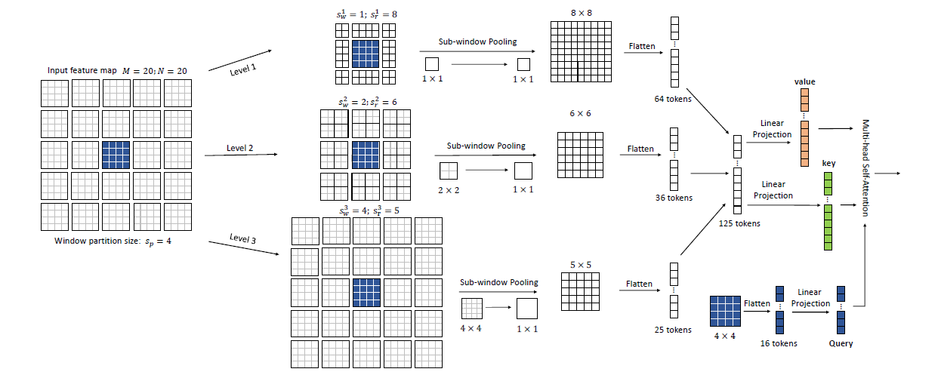
Focal Attention: Brief Review
An Illustration of Focal Self-Attention at Window Level
Notes:
Note that a strict version of focal self-attention following Fig. 1 requires to exclude the overlapped regions across different levels. In our model, we intentionally keep them in order to capture the pyramid information for the overlapped regions.

Slide 5
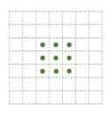
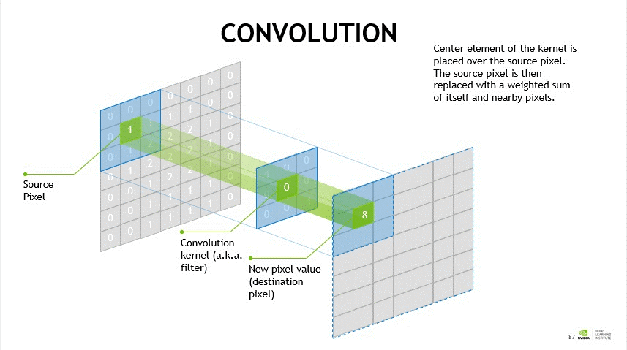
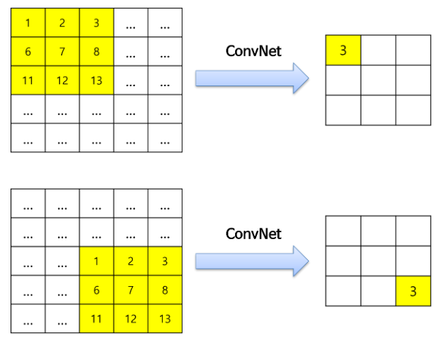
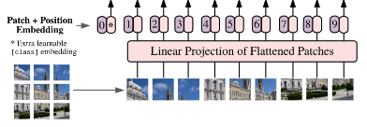
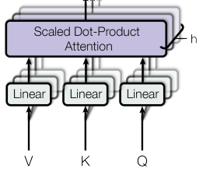
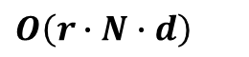
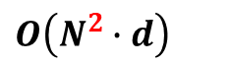
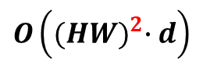
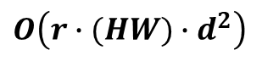
Introduction
ViT’s self-attention:
Pros
Cons
input-dependent long-range interact
quadratic complexity
input
output
CNN
(Fixed) 3x3 update
$O\left(r∙N∙d\right)$
$O\left(r∙(HW)∙d^{2}\right)$
ViT
All input update
$O\left(N^{2}∙d\right)$
$$O\left({(HW)}^{2}∙d\right)$$
5

Slide 6
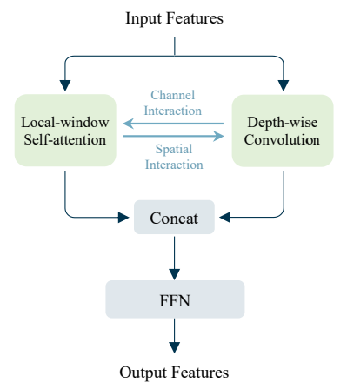
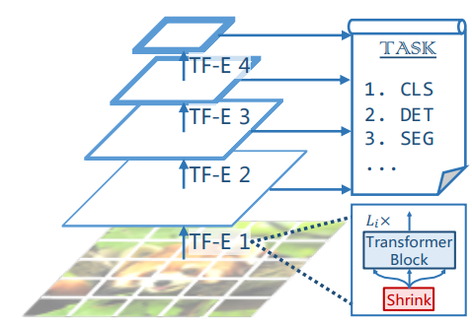
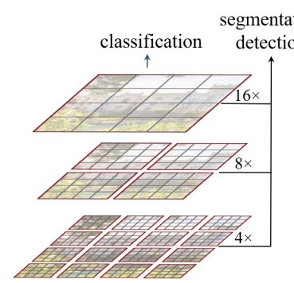
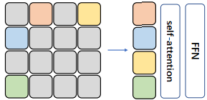
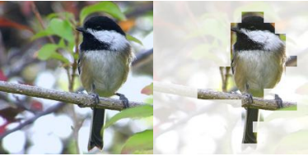
Introduction
Approaches to address self-attention’s quadratic complexity:
Token coarsening
Window attention
Dynamic token selection
(Depth-wise) convolutions
A
PVT
B
Swin-T
C
DynamicViT
D
Mixformer

Slide 7
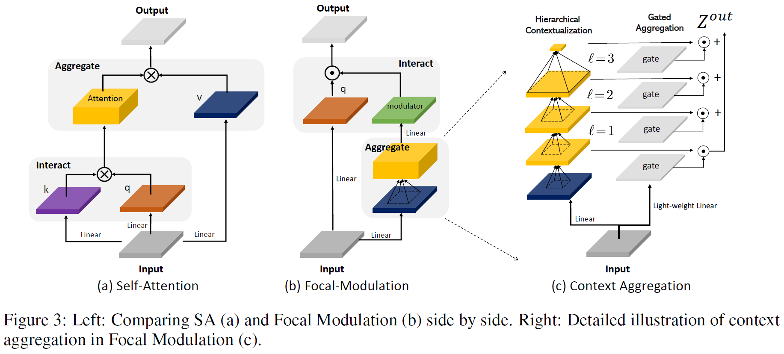
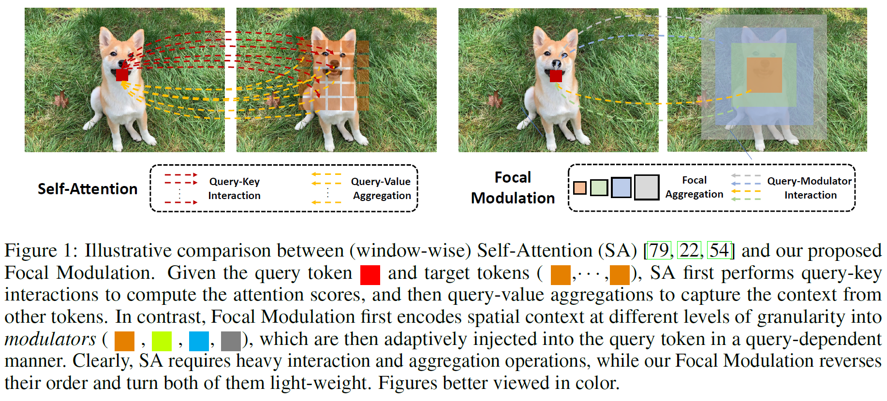
Focal Modulation Networks
Self-Attention mechanism:
Query-key interactions to compute the attention scores.
The attention scores for different queries are non-shareable.
Query-value aggregations to capture the context from other tokens.
Such heavy interactions and aggregations are necessary?
2
1
1
2

Slide 8
Focal Modulation Networks
(Proposed) Focal Modulation mechanism:
Aggregates contexts focally around each query into modulators
With shared, query-agnostic depth-wise convolution operator.
Adaptively injects them into query tokens.
Reverse the order and turn both processes lightweight.
2
1
1
2

Slide 9
Focal Modulation Networks
Multi-scale hierarchical context aggregation approach:
Hierarchical contextualization
Extracts contexts from local to global ranges at different levels of granularity.
Gated aggregation
Condenses all context features at different granularity levels into the modulator.
2
1
Notes:
Both short and long-range contexts are important for visual modeling.

Slide 10
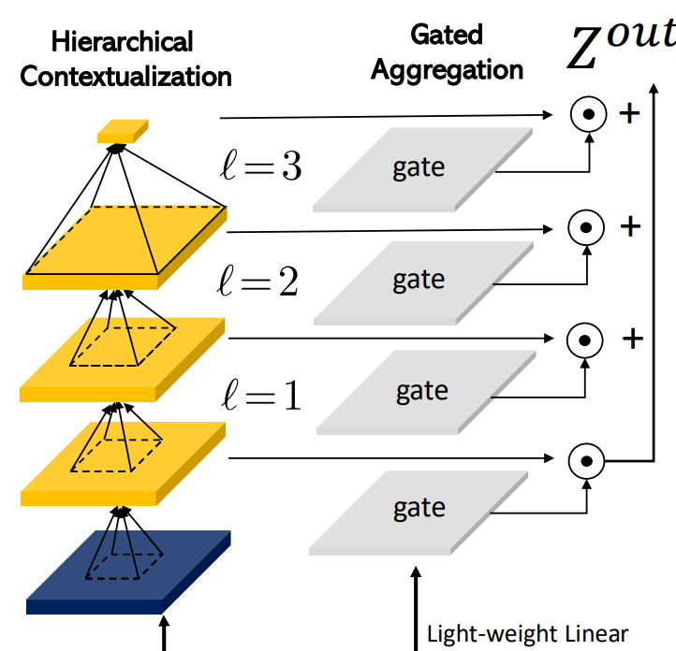
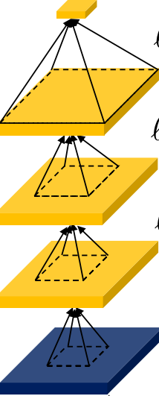
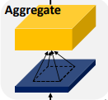
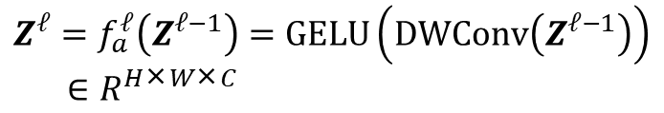
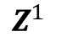
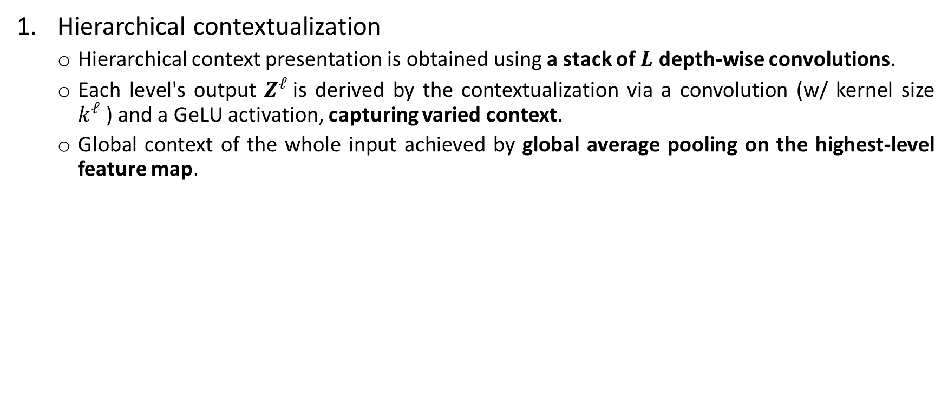
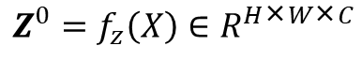
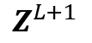
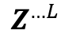
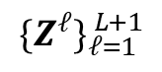
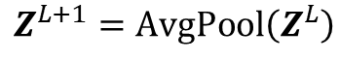
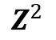
Focal Modulation Networks
Hierarchical contextualization
Hierarchical context presentation is obtained using a stack of $L$ depth-wise convolutions.
Each level's output $Z^{ℓ}$is derived by the contextualization via a convolution (w/ kernel size $k^{ℓ}$) and a GeLU activation, capturing varied context.
Global context of the whole input achieved by global average pooling on the highest-level feature map.
high
$Z^{L+1}$
$$Z^{L+1}=AvgPool\left(Z^{L}\right)$$
$$Z^{…L}$$
$${\{Z^{ℓ}\}}_{ℓ=1}^{ L+1}$$
$$Z^{2}$$
$$Z^{ℓ}=f_{a}^{ℓ}\left(Z^{ℓ−1}\right)=GELU\left(DWConv\left(Z^{ℓ−1}\right)\right)$$
$$∈R^{H\text{×}W\text{×}C}$$
$$Z^{1}$$
low
$$Z^{0}=f_{z}\left(X\right)∈R^{H\text{×}W\text{×}C}$$
Linear
Input
Notes:
Depth-wise convolution is channel-wise and thus computationally much cheaper.

Slide 11
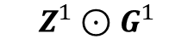
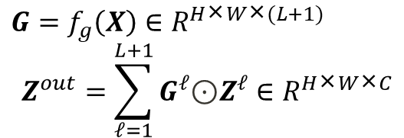
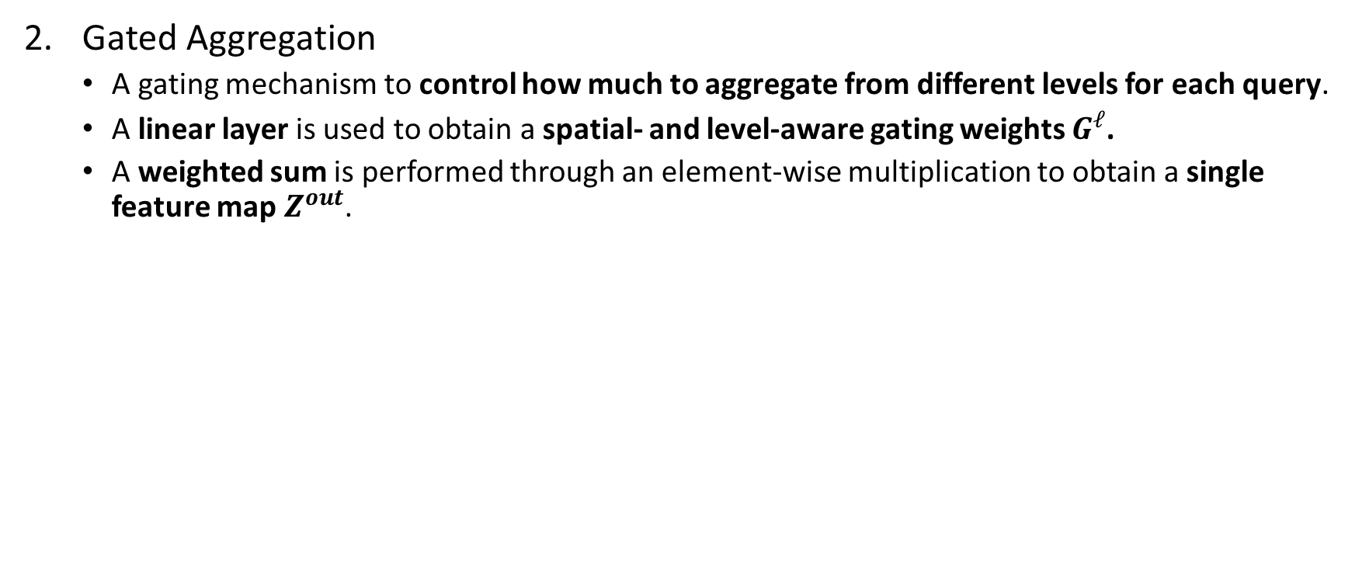
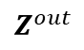
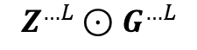

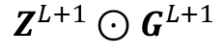
Focal Modulation Networks
Gated Aggregation
A gating mechanism to control how much to aggregate from different levels for each query.
A linear layer is used to obtain a spatial- and level-aware gating weights $G^{ℓ}$.
A weighted sum is performed through an element-wise multiplication to obtain a single feature map $Z^{out}$.
Gated Aggregation
$$Z^{out}$$
$$G=f_{g}\left(X\right)∈R^{H\text{×}W\text{×}(L+1)}$$
$$Z^{out}=\sum_{ℓ=1}^{L+1}{G^{ℓ}\text{⊙}Z^{ℓ}}∈R^{H\text{×}W\text{×}C}$$
$$Z^{L+1}⊙G^{L+1}$$
gate
+
high
+
$$Z^{…L}⊙G^{…L}$$
gate
+
$$Z^{2}⊙G^{2}$$
gate
+
$$Z^{1}⊙G^{1}$$
gate
low
Light-weight linear
Linear
Input
Notes:
In an image, the relation between a visual token (query) and its surrounding contexts often depends on the content itself. For example, the model might rely on local fine-grained features for encoding the queries of salient visual objects, but mainly global coarse-grained features for the queries of background scenes.

Slide 12
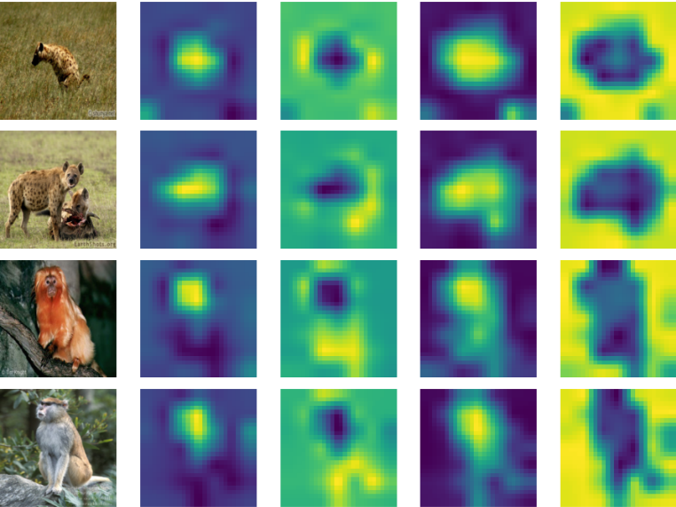
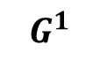
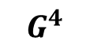
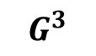
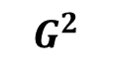
Focal Modulation Networks
Gated Aggregation
Observation: For a token on a small object, it focuses more on the fine-grained local structure at low focal level, while a token in a uniform background needs to be aware of much larger contexts from higher levels.
FocalNet indeed learns gathering the context from different focal levels adaptively.
Gated Aggregation
input
$$G^{1}$$
$$G^{2}$$
$$G^{3}$$
$$G^{4}$$
$$Z^{out}$$
$$Z^{L+1}⊙G^{L+1}$$
gate
+
high
+
$$Z^{…L}⊙G^{…L}$$
gate
+
$$Z^{2}⊙G^{2}$$
gate
+
$$Z^{1}⊙G^{1}$$
gate
low
Light-weight linear
Linear
Input

Slide 13
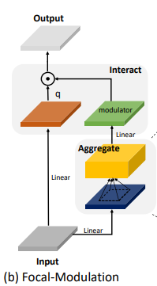
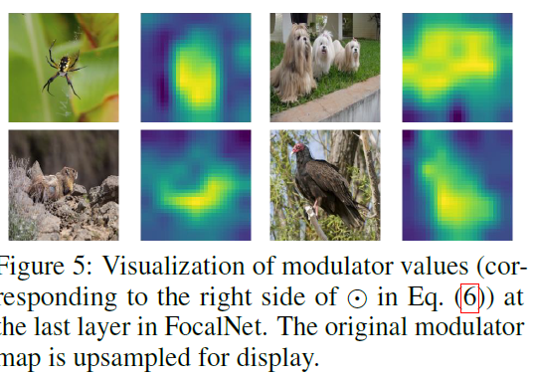
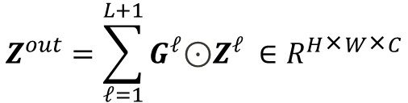
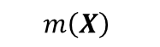
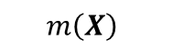
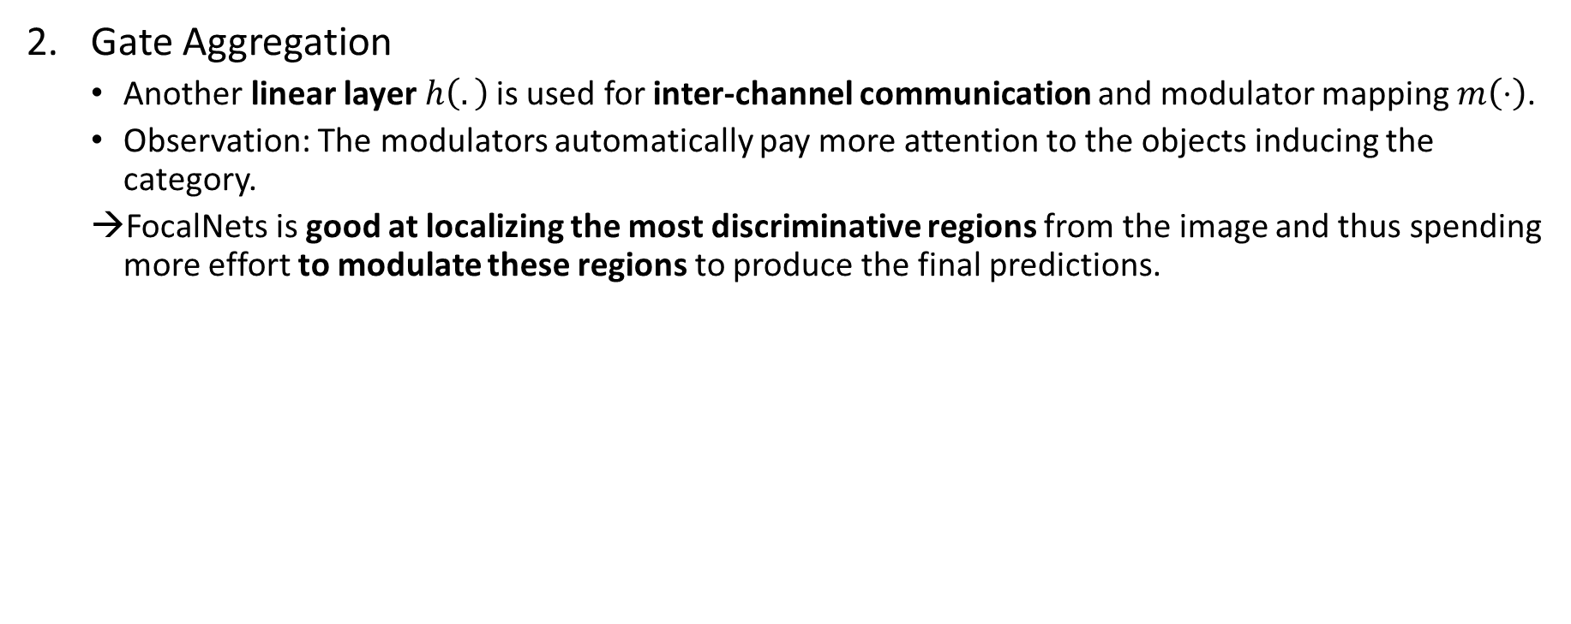
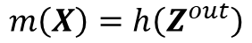
Focal Modulation Networks
Gate Aggregation
Another linear layer $h\left(.\right)$is used for inter-channel communication and modulator mapping $m\left(⋅\right)$.
Observation: The modulators automatically pay more attention to the objects inducing the category.
FocalNets is good at localizing the most discriminative regions from the image and thus spending more effort to modulate these regions to produce the final predictions.
input
$$m\left(X\right)$$
input
$$m\left(X\right)$$
$$m\left(X\right)=h\left(Z^{out}\right)$$
$$Z^{out}=\sum_{ℓ=1}^{L+1}{G^{ℓ}\text{⊙}Z^{ℓ}} ∈R^{H\text{×}W\text{×}C}$$

Slide 14
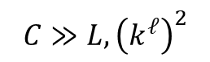


Focal Modulation Networks
Focal Modulation can be rewritten at the token level as
$$y_{i}=q\left(x_{i}\right) \text{⊙} m\left(i,X\right)=q\left(x_{i}\right) \text{⊙} h\left(\sum_{ℓ=1}^{L+1}{{ g}_{i}^{ℓ}\text{⊙}Z_{i}^{ℓ}}\right)$$
Complexity:
2
1
Self-Attention in Vanilla ViT | Self-attention in Swin | FocalNet
$$O\left({\left(HW\right)}^{2}C+HW×\left(3C^{2}\right)\right)$$ | $$O\left(HW×\left(3C^{2}+2Cw^{2}\right)\right)$$ | $$O\left(HW×\left(3C^{2}+C\left(2L+3\right)+C\sum_{ℓ}{{\left(k^{ℓ}\right)}^{2}}\right)\right)$$
$$C≫L,{\left(k^{ℓ}\right)}^{2}$$

Slide 15
Focal Modulation Networks
Properties
Input-dependent
Dynamic focusing
Decouple feature granularity
Q preserve the finest information
M extracts the coarser context
Spatial- and channel- specific
Depth-wise convolution
Global average pooling
Better complexity
No quadratic complexity
No positional encoding
Feature maps preserve positional information

Slide 16


Focal Modulation Networks
Network architectures
Have same stage layouts and hidden dimensions as in Swin Transformers, but replace the Self-Attention modules with the Focal Modulation modules.

Slide 17


Experiment – Classification
ImageNet-1K

Slide 18



Experiment – Object Detection & Instance Segmentation
COCO 2017

Slide 19

Experiment – Object Detection & Instance Segmentation
COCO 2017
At scale wit huge backbone

Slide 20



Experiment – Semantic & Panoptic Segmentation
ADE20K (semantic segmentation) & COCO (panoptic segmentation)

Slide 21



Experiments – Comparison with ViTs and ConvNeXts
ConvNeXts:
ViTs: all Self-Attention modules replaced with Focal Modulation to construct monolithic FocalNet-T/S/B
Images from ImageNet-1K validation set

Slide 22



Ablation

Slide 23
Conclusion
Focal Modulation: a new and generic mechanism that enables input-dependent token interactions for visual modeling
Hierarchical contextualization to gather for each query token its contexts from short- to long-range,
Gated aggregation to adaptively aggregate context features based on the query content into modulator.
FocalNets significantly outperform leading self-attention models (e.g., Swin, Focal Transformer) in image classification, object detection, and semantic segmentation.
Future work: verify whether Focal Modulation can be applied to other domains such as NLP, multi-modal tasks.
2023: Focal Modulation already applied to 3D & Video processing tasks.
Notes:
In 2023 Focal modulation is already applied to 3D / Video processing tasks

Slide 24
Thank you for listening

